Slide 1
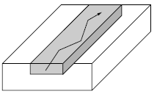
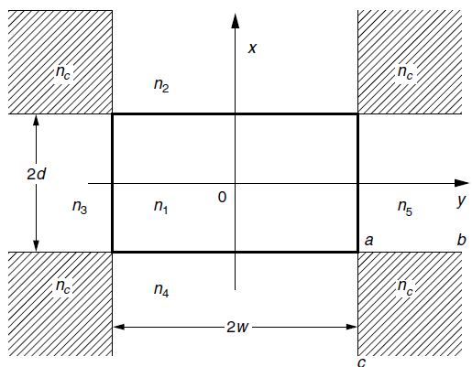
Channel Waveguides Rectangular Waveguide
Assumptions:
Difference in the indices of refraction of the cladding and the core is small so that all the guided component waves make a small angle with the z axis.
Hatched regions may be ignored without serious error.

Slide 2
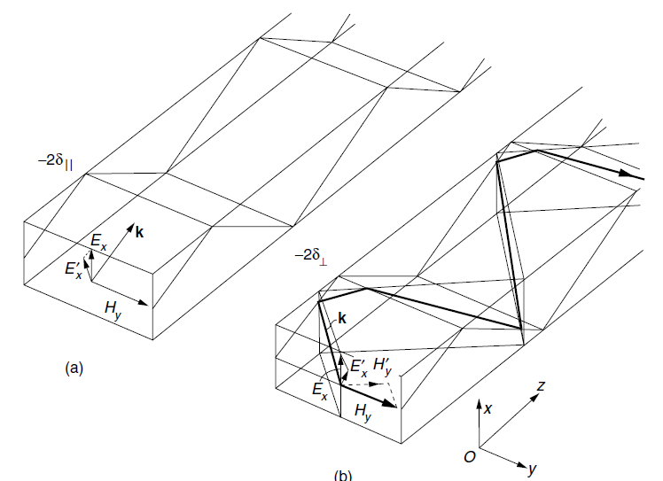
TE-Like & TM-Like Modes

Slide 3
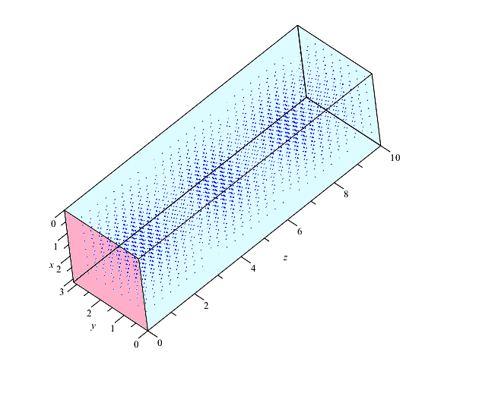

Slide 4
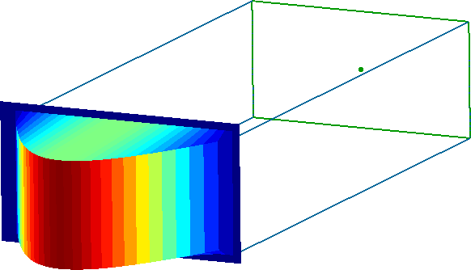
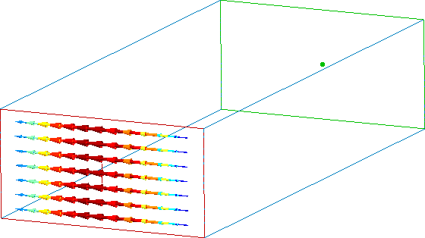
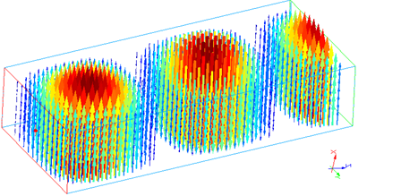

Slide 5
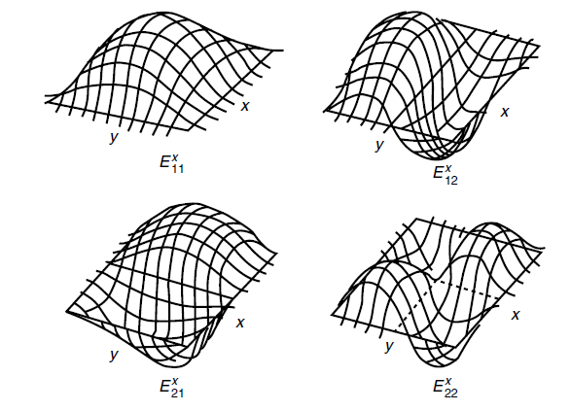

Slide 6
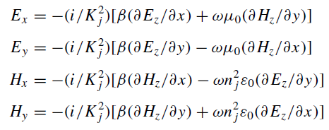


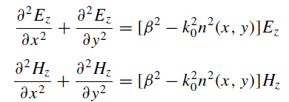
Marcatili's method

Slide 7
Characteristic Equation for the Rectangular Guide

Slide 9
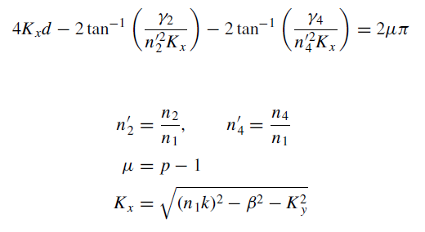
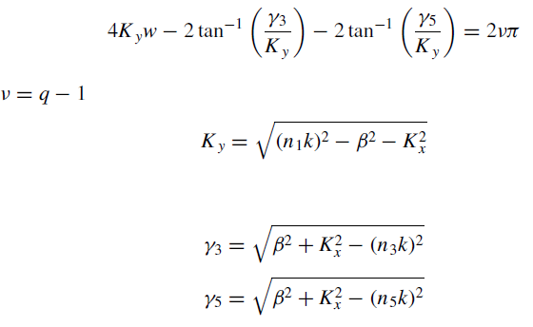
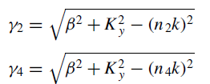
Characteristic Equation for the Rectangular Guide

Slide 10
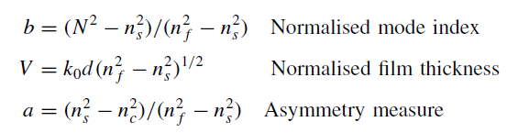
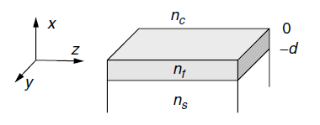
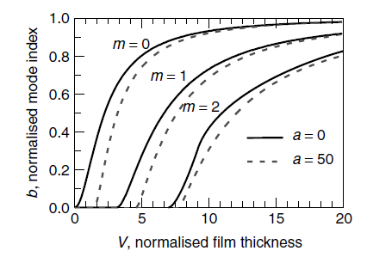
normalized mode index: b
As the effective refractive index corresponding to a confined mode is in the range ns < N < nf , the normalized mode index b is bounded to 0 < b < 1.
The normalized film thickness V is directly connected to the relative thickness of the waveguide core (film) with respect to the working wavelength, that is, V ∝ d/λ,
The asymmetry measure a is zero in the case of symmetric waveguides, and increases as the refractive index difference between the cover and substrate increases.

Slide 11
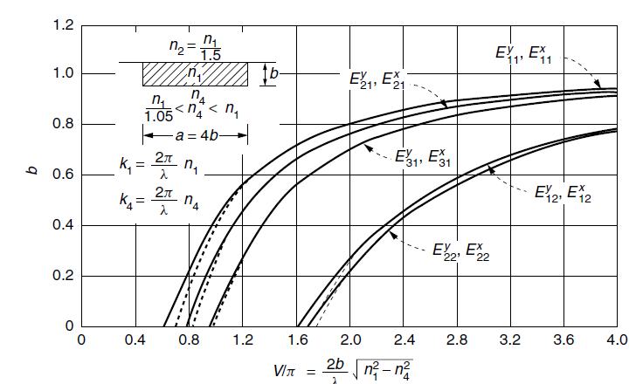
normalized mode index for rectangular waveguide

Slide 12
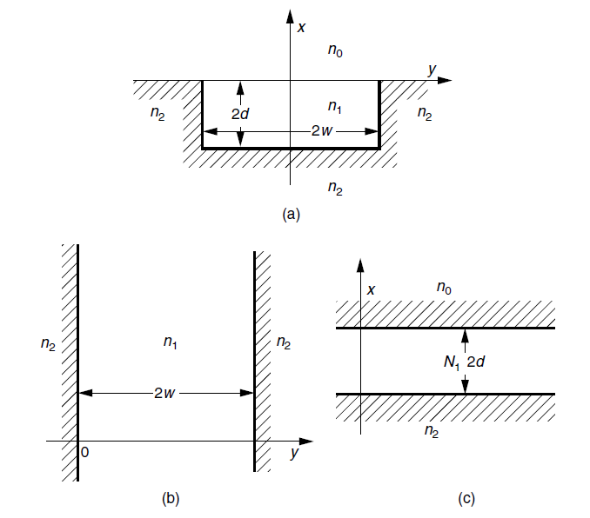
Effective index method

Slide 13
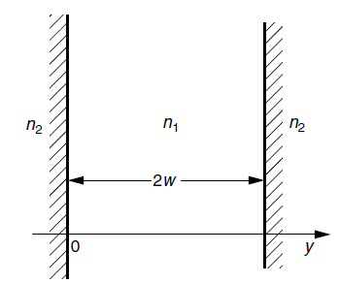
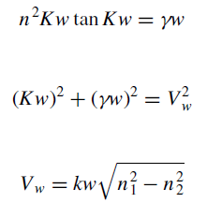



Effective index method
Step 1

Slide 14
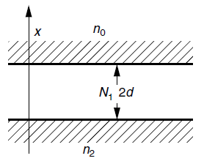
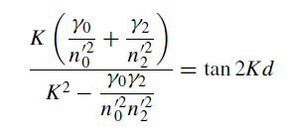
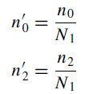



Effective index method
Step 2:

